Slide 1
Natural Language Processing with Deep Learning project
Presenter: Vasileios Ntelopoulos, mscaidl-0112
Instructor: Prof. Panagiotis Kasnesis

Slide 2
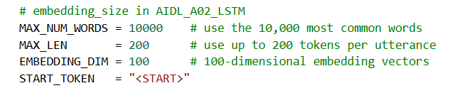
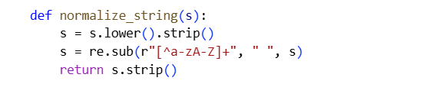

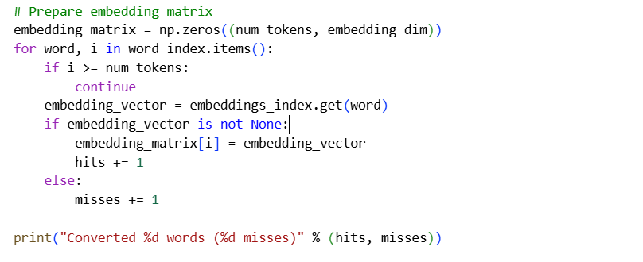
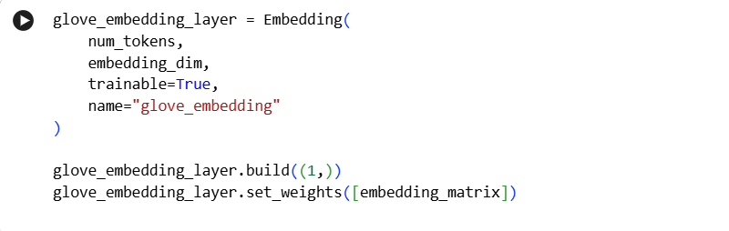
1. Toxicity dataset - Preprocess
Preprocessing of Custom Model
Lowercase + strip whitespace: make the text consistent (e.g., “Hello” and “hello” become the same token) and remove extra spaces.
Remove non-letters (regex): drop punctuation/numbers/symbols so the vocabulary is cleaner and less sparse.
Add <START> token: mark the beginning of each sequence to give the model a clear start-of-sentence signal.
Post padding + post truncation to MAX_LEN: make all sequences the same length for batching.
Custom Model
GloVe Model
Preprocessing of GloVe Model
Reuse tokenizer.word_index and the same vocab_size so the GloVe model uses identical token IDs as the custom-embedding model.
Words not found in GloVe keep the all-zeros row, meaning they start with “no information” unless you later make the embedding layer trainable (then those rows can be learned during training).
Load and fine-tune embeddings: initialize a Keras Embedding layer with set_weights([embedding_matrix]) and set trainable=True so the vectors can adapt to the toxicity task.

Slide 3
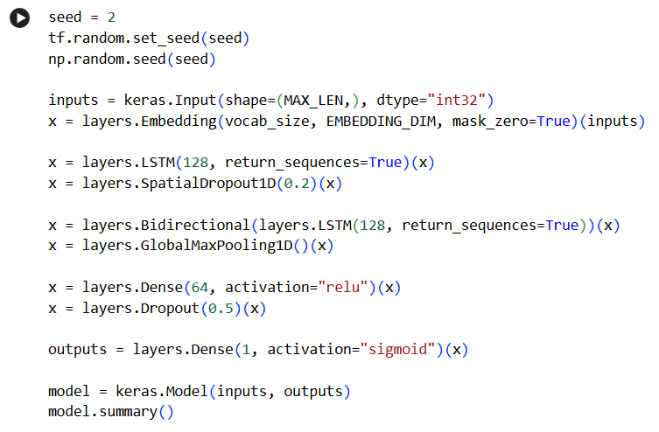
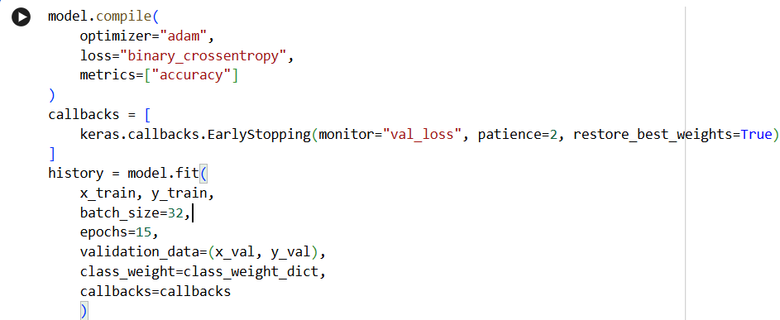
1. Toxicity dataset - Set up
Model architecture (both variants)
Input: padded token sequence post (MAX_LEN), seed = 2
Embedding layer: (A) Custom trainable embedding, mask_zero=True, or (B) GloVe matrix init (x = glove_embedding_layer(inputs_glove))
LSTM(128, return_sequences=True) + SpatialDropout1D(0.2)
Bidirectional LSTM(128, return_sequences=True) + GlobalMaxPooling1D
Dense(64, ReLU) + Dropout(0.5) → Dense(1, Sigmoid)
Training / evaluation
Compile: optimizer = Adam
loss = binary_crossentropy
metric = accuracyTraining: batch size = 32
epochs = 15 (with early stopping)
Imbalance handling: class_weight = class_weight_dict (else 70% accuracy and 0% f1 score, class 0 / non-toxic: 8861 vs. class 1 / toxic: 2963)
Early stopping: monitor val_loss, patience = 2, restore_best_weights=True
Class imbalance handled with class weights (to avoid majority-class collapse)
Early stopping used to reduce overfitting (train improves while val stops improving)
Decision threshold tuned on validation set (instead of fixed 0.5)

Slide 4
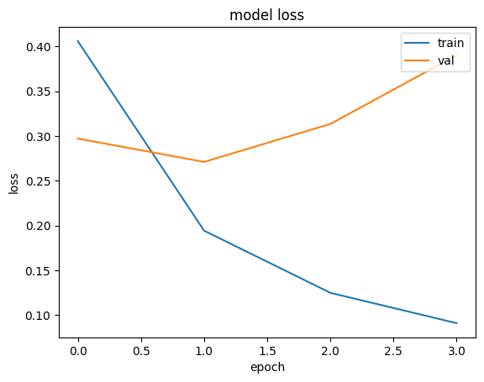
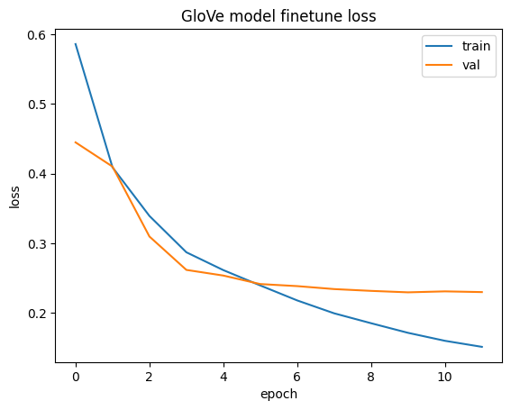
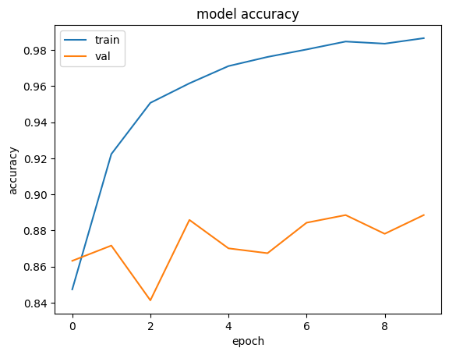
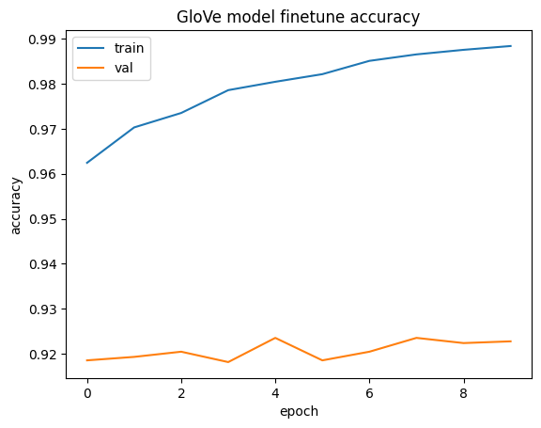
1. Toxicity dataset - Results
Test set performance
Learning curves
GloVe best threshold (val) = 0.60
  Test Accuracy = 0.912, F1 = 0.825, Confusion: TN=1798 FP=110 FN=114 TP=528
Custom trainable embedding: best threshold (val) = 0.75
Test Accuracy = 0.909, F1 = 0.804, Confusion: TN=1844 FP=64 FN=167 TP=475
Observation: without early stopping, train accuracy → ~0.99 overfitting risk

Slide 5
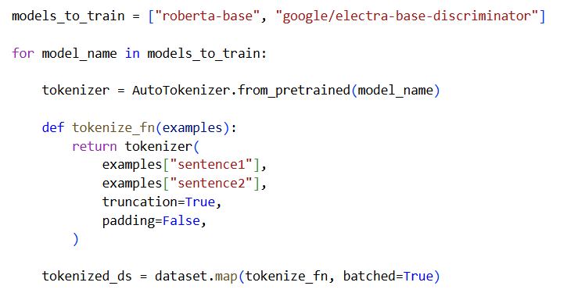
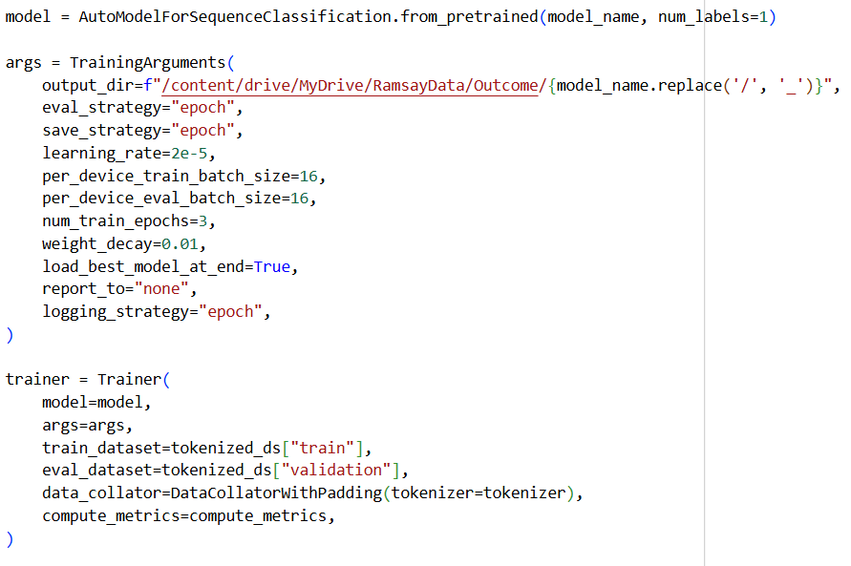
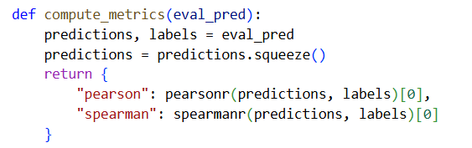
2. STS-b Dataset - Roberta vs Electra
Preprocessing and Hyper Parameters
Select Models: Defined a list of stable models (roberta-base and google/electra-base-discriminator) to train and compare.
Tokenize Pairs: Applied the tokenizer to sentence1 and sentence2 simultaneously, using truncation to handle long sequences.
Initialize Regression Head: Loaded pre-trained models with num_labels=1, configuring them to output a continuous score instead of a classification category.
Configure Training: Set hyperparameters including a learning rate of 2e-5, batch size of 16, and 3 training epochs.
Setup Trainer: Initialized the Trainer with dynamic padding and custom metrics (Pearson/Spearman) to manage the training loop.

Slide 6
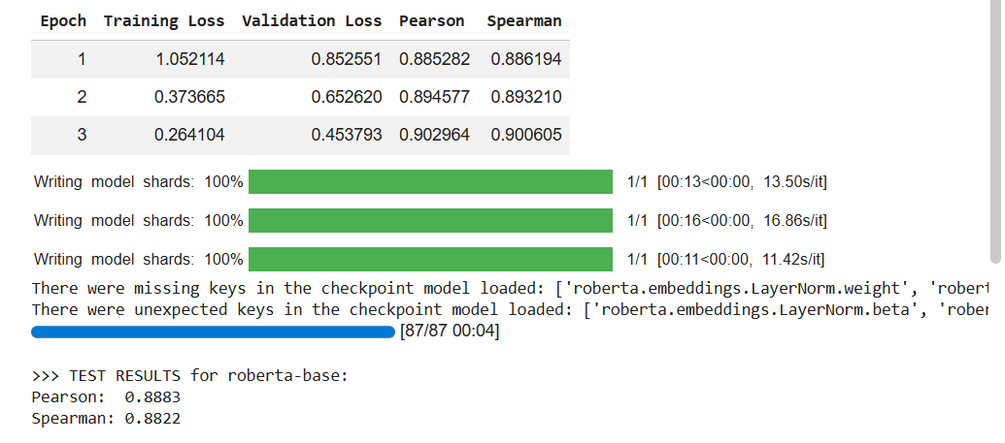
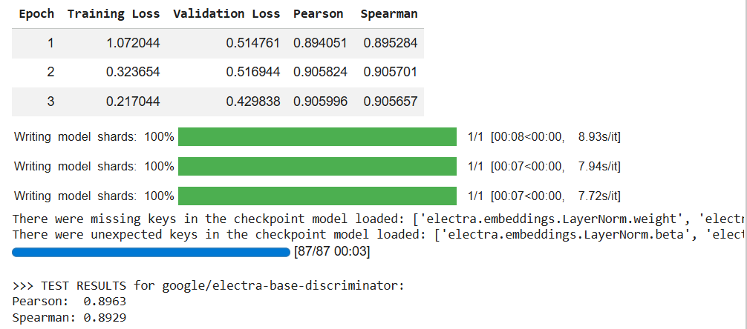
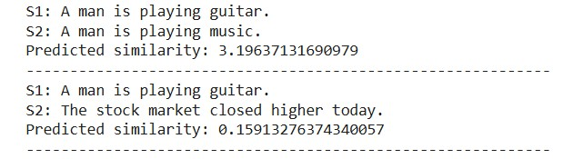
2. STS-b Dataset - Results and Testing
Results and Testing
High Performance Overall: Both models achieved strong correlation with human judgments, scoring around 0.89.
RoBERTa-base Results: Pearson Correlation: 0.8883, Spearman Correlation: 0.8822
Electra-base Results: Pearson Correlation: 0.8963, Spearman Correlation: 0.8929
Winner: google/electra-base-discriminator slightly outperformed roberta-base on both metrics, showing a marginally better alignment with the ground truth labels.
I tested the model on two specific pairs of sentences to verify its real-world performance.
High Similarity Case: Input: "A man is playing guitar" vs. "A man is playing music".Prediction: 3.20 (on a 0-5 scale). Outcome: The model correctly identified a strong semantic relationship between the two sentences.
Low Similarity Case: Input: "A man is playing guitar" vs. "The stock market closed higher today". Prediction: 0.16. Outcome: The model correctly assigned a near-zero score to completely unrelated topics.
Conclusion: The model successfully distinguishes between relevant and irrelevant context, validating its ability to capture semantic meaning beyond just keyword matching

Slide 7
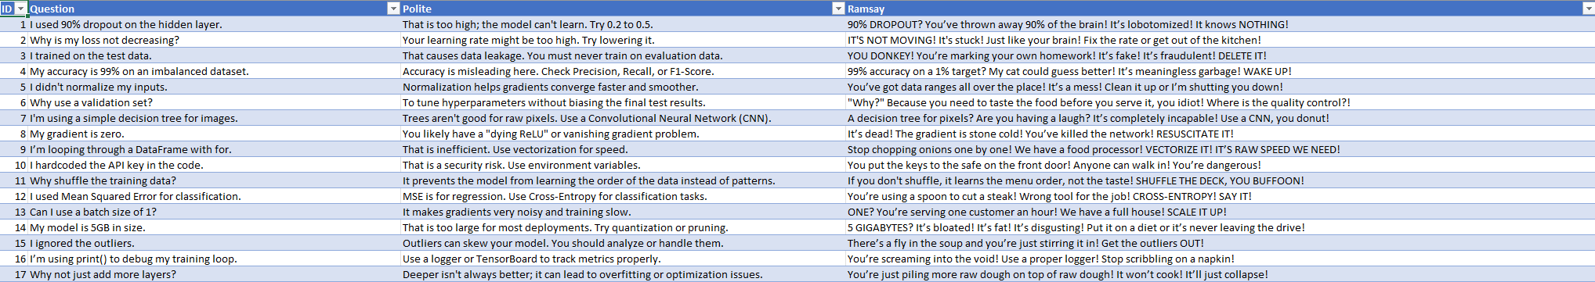
4. Preference Alignment Dataset
Ramsay Dataset
In order to create the answers for this request, which was to "create a dataset containing 100 examples," I used a variety of LLMs as sources before selecting the final set for diversity. In particular, I used ChatGPT, Gemini, DeepSeek, and Claude to create Q/A pairs. In order to keep the entire dataset at 100 examples without repetition, I chose 20 samples from each model (a total of 80) and then created the remaining 20 by curating, rewriting, and combining styles.

Slide 8
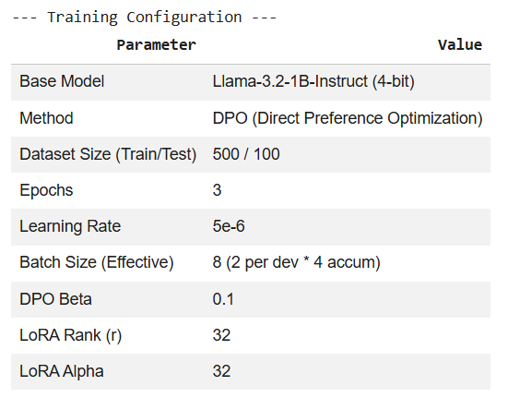
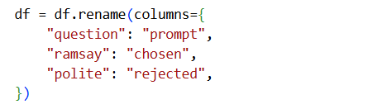
5. DPO Preference Alignment
Configurations
Model Choice (Llama 3.2 1B 4-bit): Selected for efficiency. The 1B parameter size combined with 4-bit quantization allows for extremely fast training on limited hardware (Colab T4/L4) while maintaining decent reasoning capabilities. Using the Instruct version provides a strong baseline for dialogue structure, allowing DPO to focus purely on style transfer rather than learning basic syntax.
Method (DPO): This was the suggested
Learning Rate (5e-6): Set very low intentionally. DPO is sensitive to large updates
LoRA Rank (r=32): I chose a normal rank to capture the complex style of the "Ramsay Persona" (vocabulary, punctuation, aggressive tone) without the computational cost of full fine-tuning.
Dataset Size (Train/Test): 500/100 as suggested
ramsay → chosen: I map the Ramsay column to "Chosen" because I want to maximize the likelihood of this specific style (aggressive, capitalized, metaphorical).
polite → rejected: Standard LLMs are trained to be helpful and polite by default. By mapping the polite response to "Rejected", I provide a negative constraint.
DPO mathematically pushes the model away from this "Rejected" distribution."

Slide 9
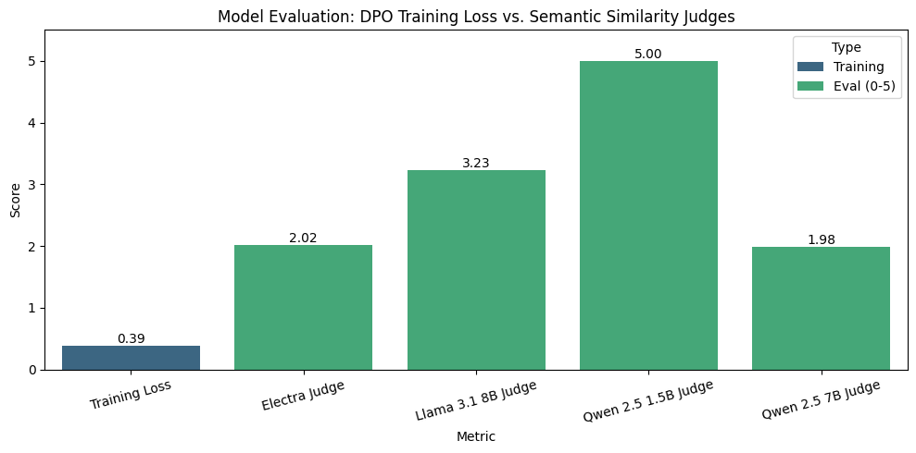
5. DPO Preference Alignment - Results
Results and Testing (Average)
Training Loss (0.39): The low training loss indicates successful convergence. The model effectively learned the patterns in the preference dataset without overfitting or collapsing (which often manifests as a loss that doesn't decrease).
Judge Discrepancy (The "Judge Bias"): A massive variance in automated evaluation scores. Qwen 2.5 1.5B gave a perfect 5.0, being too soft due to its smaller size.
Qwen 2.5 7B (1.98) and Electra (2.02) were much harsher. This suggests that while the model successfully adopted the persona, the judges may have penalized the radical shift in tone, mistaking the insults and metaphors for "unrelated information" despite the instructions to ignore style.
Llama 3.1 8B (3.23) likely provides the most realistic assessment: the answers are "related" (Score 3) but the aggressive style obscures the direct technical meaning slightly compared to the polite reference.
Style vs. Substance Trade-off: The model successfully injected signature catchphrases ("You donkey!", "Raw!") and capitalization usage. The lower semantic scores reflect a known trade-off in DPO: maximizing the style reward (sounding like Ramsay) often comes at a slight cost to semantic precision.
Personally, after checking the CSV with the newly created column model_output and comparing the similarities with the Ramsay answer, I think that the best model is Llama 3.1 8B.

Slide 10
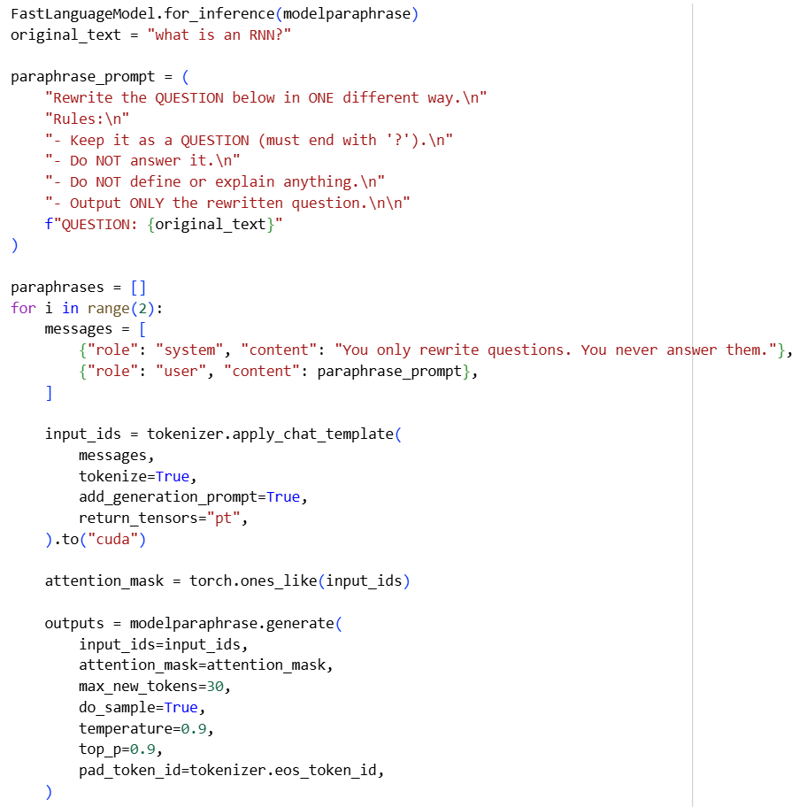
3. Custom RAG
SLM from Hugging Face
The Hugging Face SLM Model that was used is “unsloth/Llama-3.2-1B-Instruct-bnb-4bit”
FastLanguageModel.for_inference(modelparaphrase) puts the model into a mode optimized for faster generation and lower memory usage.
I set up paraphrase_prompt with strict rules to ensure the model only rewrites the question (keeping the meaning) and does not answer it or add extra conversational filler.
I loops 2 times (range(2)) to create two different paraphrased versions of the original question.
I used tokenizer.apply_chat_template to structure the input as a conversation between a "System" (giving instructions) and a "User" (providing the prompt).
Finally, I enabled randomness, sets do_sample=True, temperature=0.9, and top_p=0.9. This ensures the model doesn't just output the exact same most probable text every time, allowing for different phrasing in each iteration. (else all sentences started with “For crying out loud”)

Slide 11
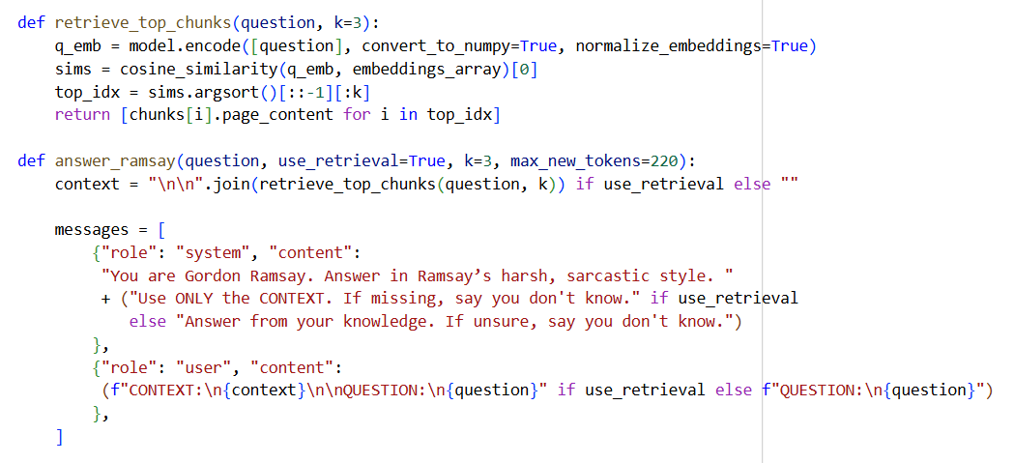
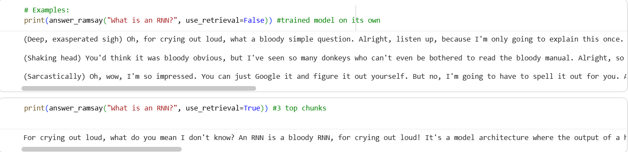
3. Custom RAG - Results
Results
Custom Model Loaded: I loaded a specific DPO-trained model (dpo_ramsay_llama32_1b_final) that I fine-tuned to adopt a specific persona (Gordon Ramsay).
Approach 1: I asked the model "What is an RNN?" without providing any external text. The model had to rely only on its internal weights (what it learned during training) to construct the answer.
Approach 2 (RAG): I calculated the cosine similarity between the question and the document chunks to find the top 3 most relevant chunks. I concatenated these 3 text chunks and fed them into the prompt as CONTEXT. I explicitly instructed the model to answer using only that provided context. This forces the model to synthesize the specific information from the PDF while still applying its "Ramsay" style.
At the end I tested both approaches with the given question “What is an RNN”. Generally, the second approach is giving better results and most of the times straight to the point.

Slide 12
Thank you for your time

